Slide 2
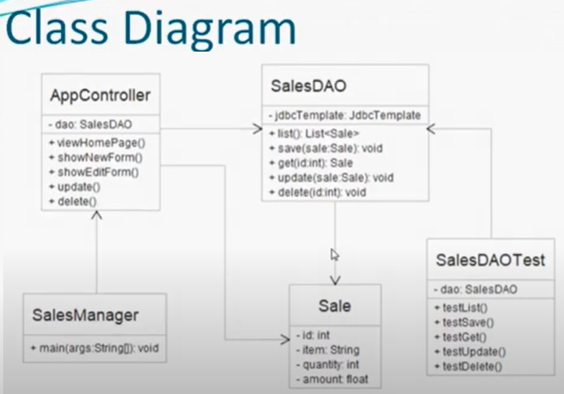

Slide 3
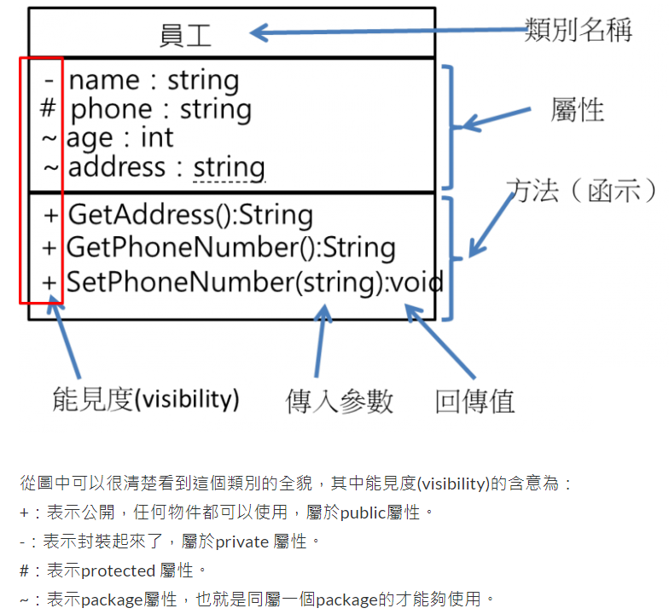
Notes:
1. 軟體路上不孤單Day16-UML介紹1-類別圖: https://ithelp.ithome.com.tw/articles/10102093

Slide 4
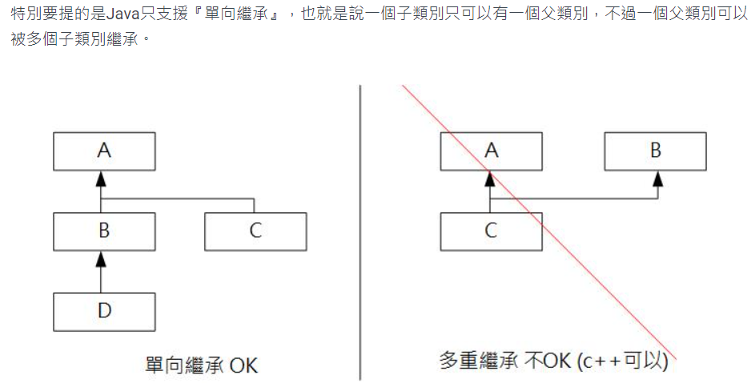
Notes:
Java 備忘筆記
-為什麼需要繼承？ Why Inheritance?: https://yubin551.gitbook.io/java-note/object_oriented_programming/inheritance
-何謂介面？ What is Interface?:: https://yubin551.gitbook.io/java-note/object_oriented_programming/interface

Slide 5
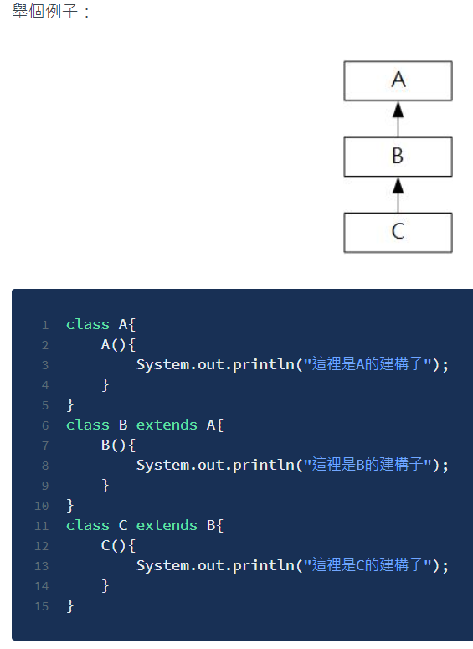
Notes:
https://yubin551.gitbook.io/java-note/object_oriented_programming/inheritance

